Slide 1
Mere mortals
Donish, Naoko, Nelson, Nicholas, and Yogi

Slide 2
Topic intro
Please feel free to step out for 10 minutes if this isn’t for you

Slide 3
hypothesis
H₁: Infant mortality differs based on GDP (per capita)
H₀: No difference in infant mortality based on GDP

Slide 4



Data sources
Mortality & Pop. Data,
ICD (diagnosis) codes,
GDP (per capita),
by Country
Correlative factors (i.e., UN Happiness Index)

Slide 5
Data cleansing / exploration

Slide 6
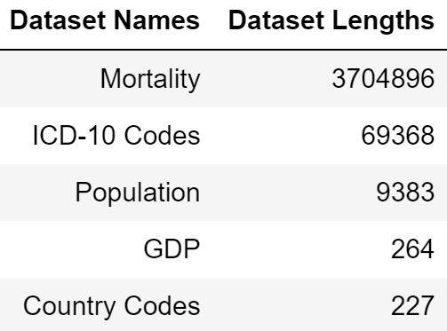
Datasets, sorted by length

Slide 7
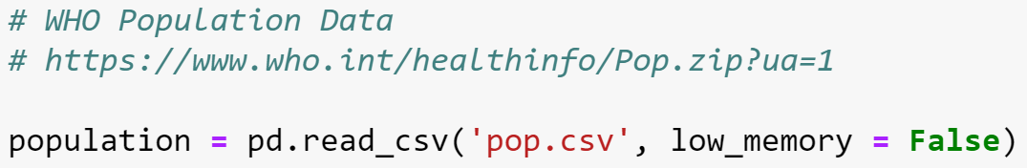
Who population data

Slide 8
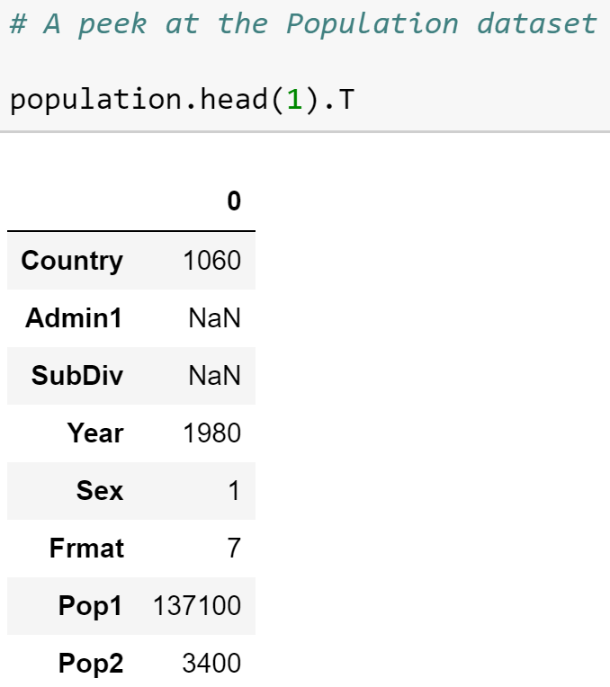
WHO Population data

Slide 9
WHO Population data

Slide 10
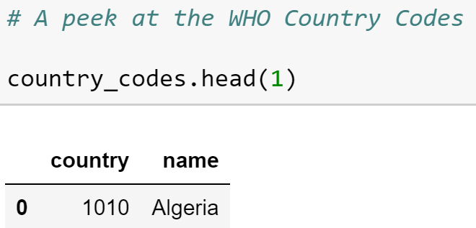
Country codes

Slide 11
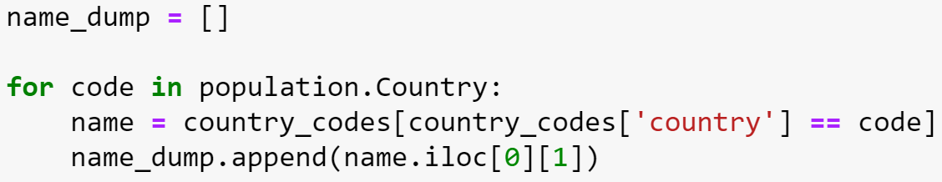
Convert codes to names

Slide 12
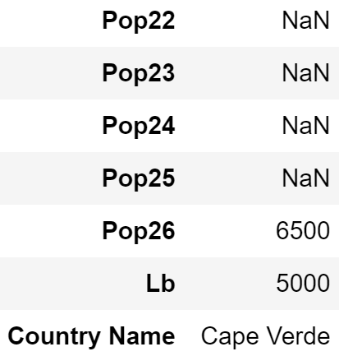
Country name added to dataframe

Slide 13
WHO Population data

Slide 14
WHO Population data

Slide 15
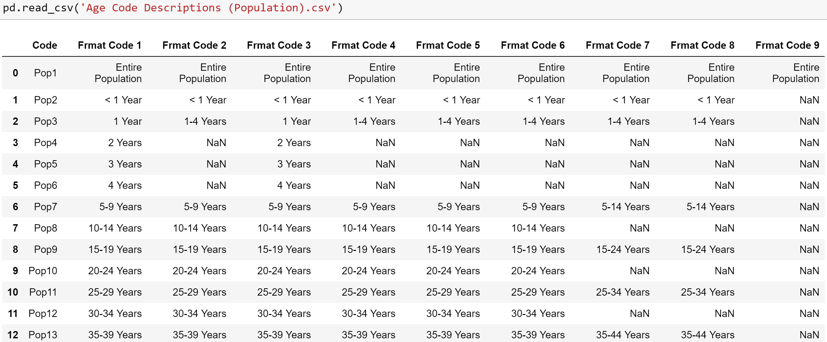
Age groupings vary based on ‘frmat’ code used

Slide 16
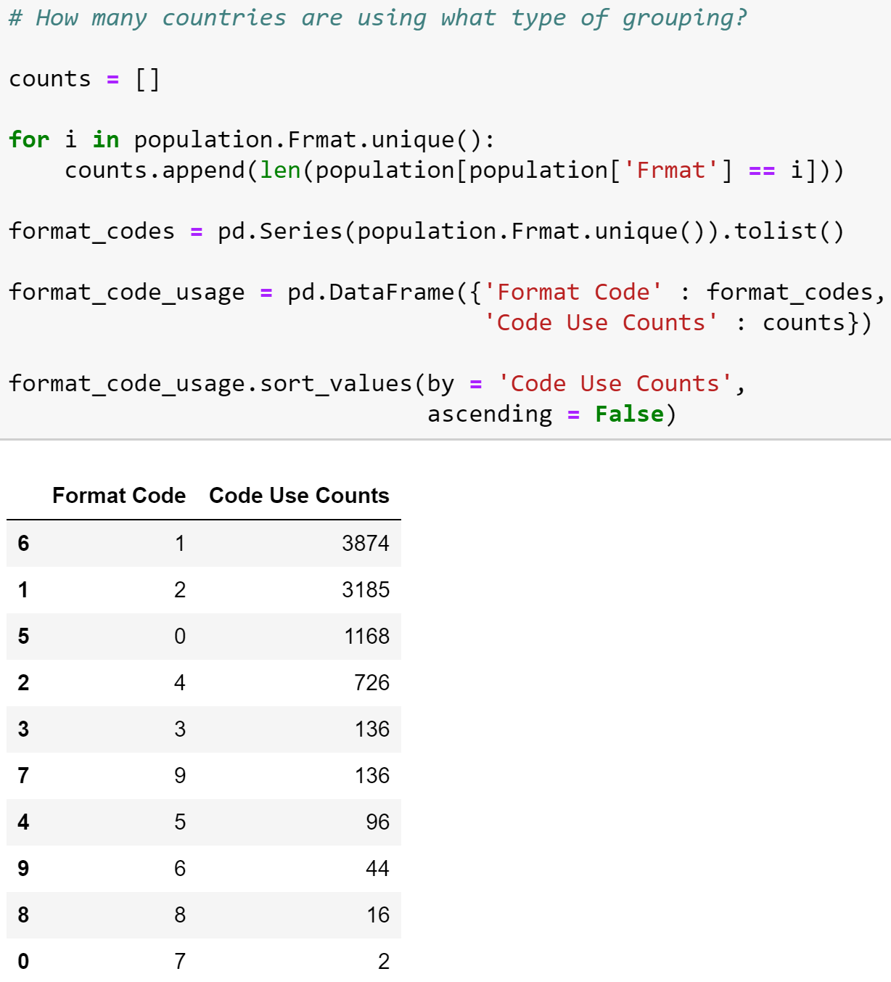
‘Frmat’ code use counts

Slide 17
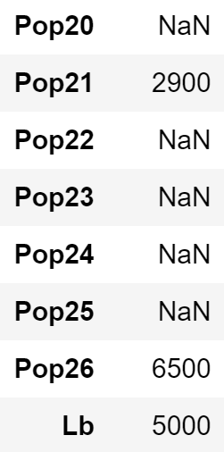
Who population data

Slide 18
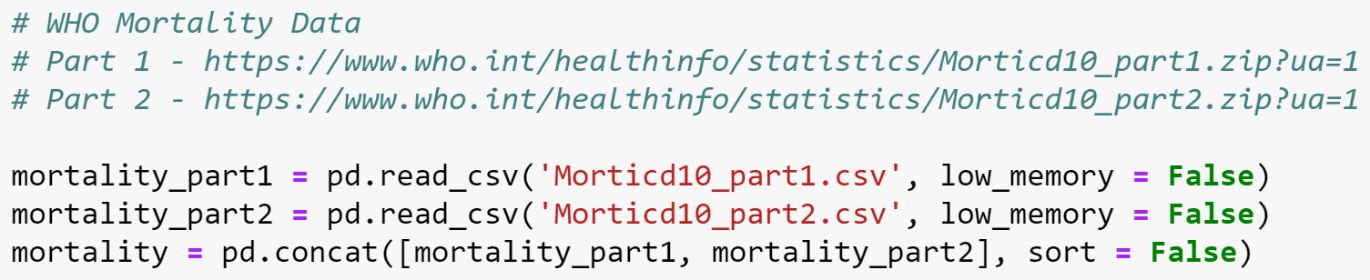
Who Mortality data

Slide 19
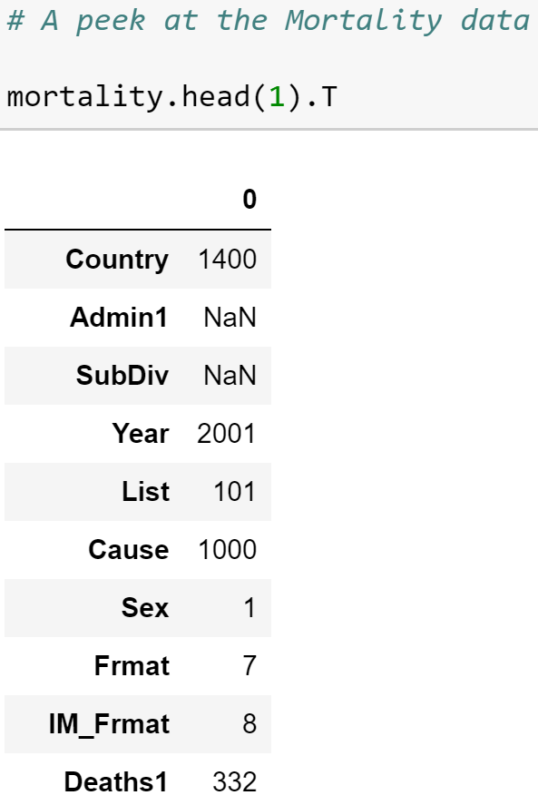
Who mortality data

Slide 20
Who mortality data

Slide 21
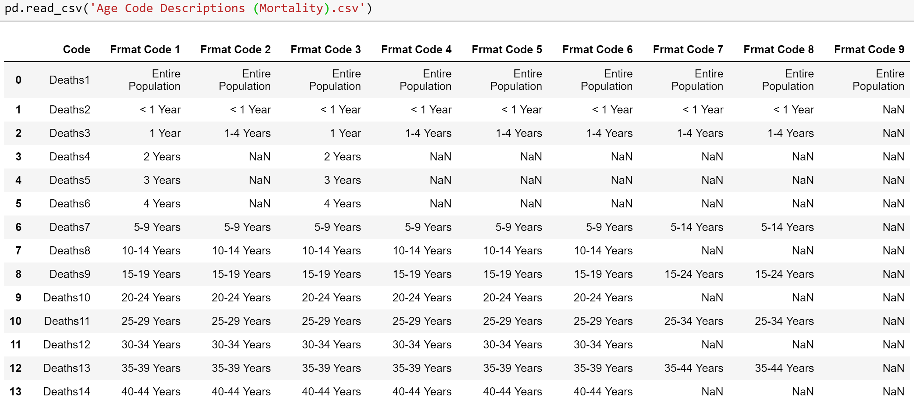
Age groupings vary based on ‘frmat’ code used

Slide 22
‘Deaths2’ selected as our focus

Slide 23
Who mortality data

Slide 24
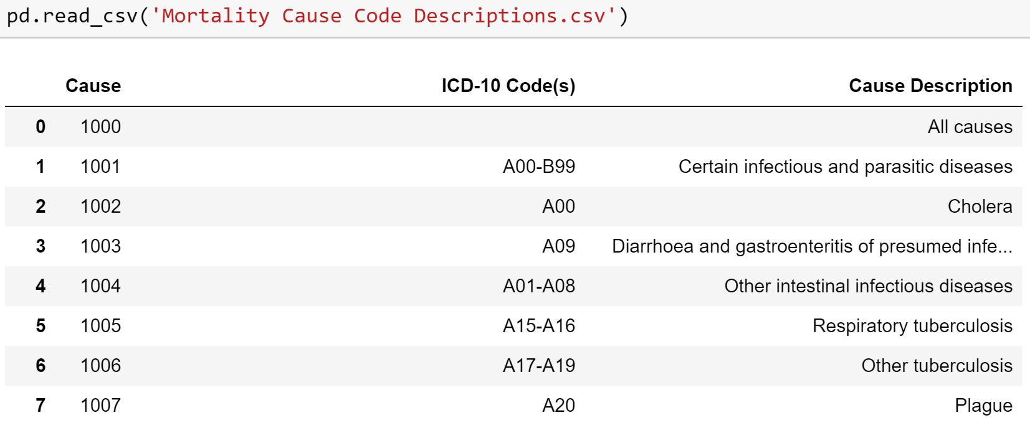
Cause code descriptions

Slide 25
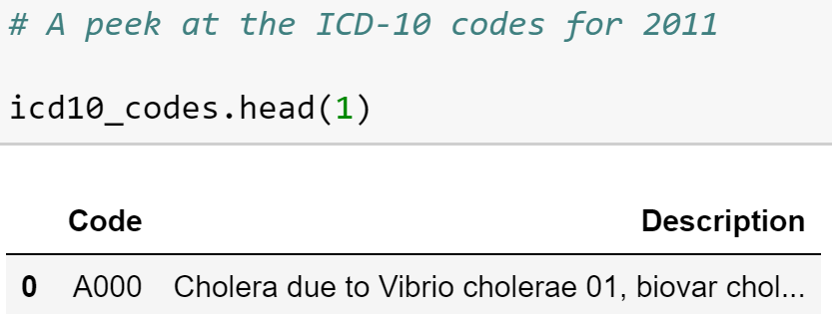
Icd-10 codes

Slide 26
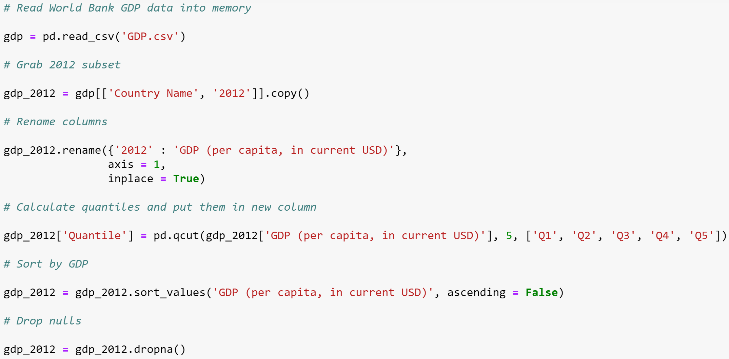
World bank gdp data

Slide 27
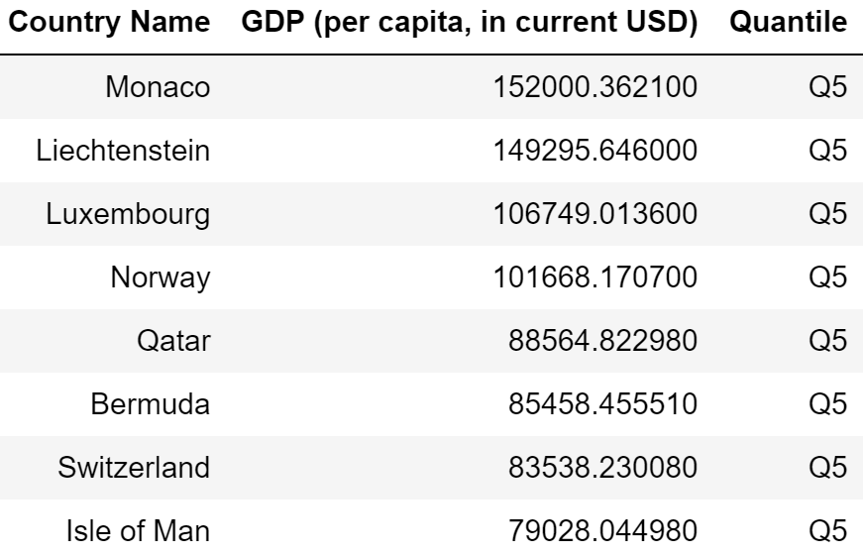
World bank gdp data

Slide 28
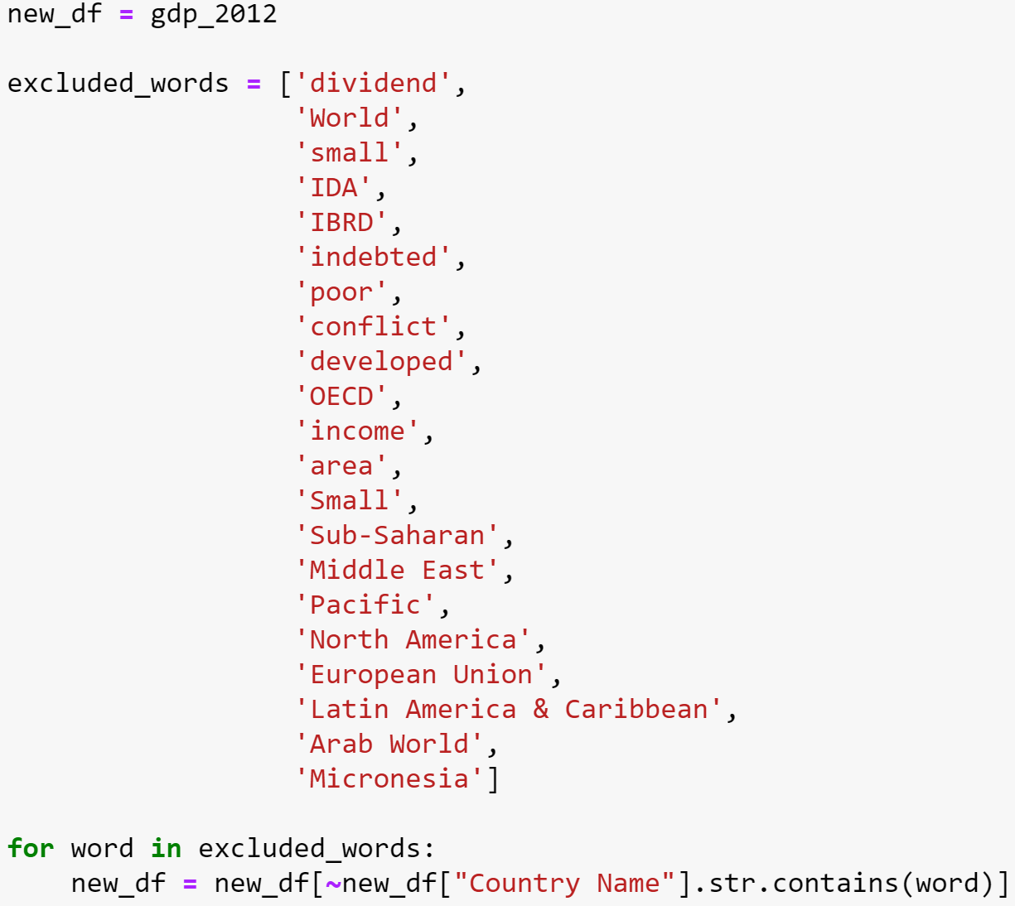
World bank gdp data

Slide 29
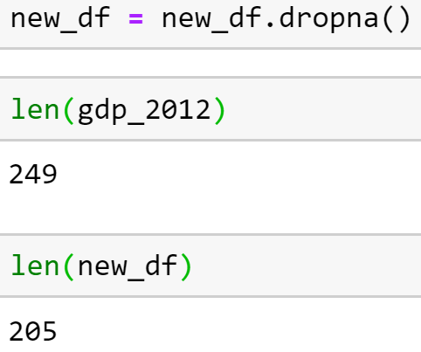
World bank gdp data

Slide 30
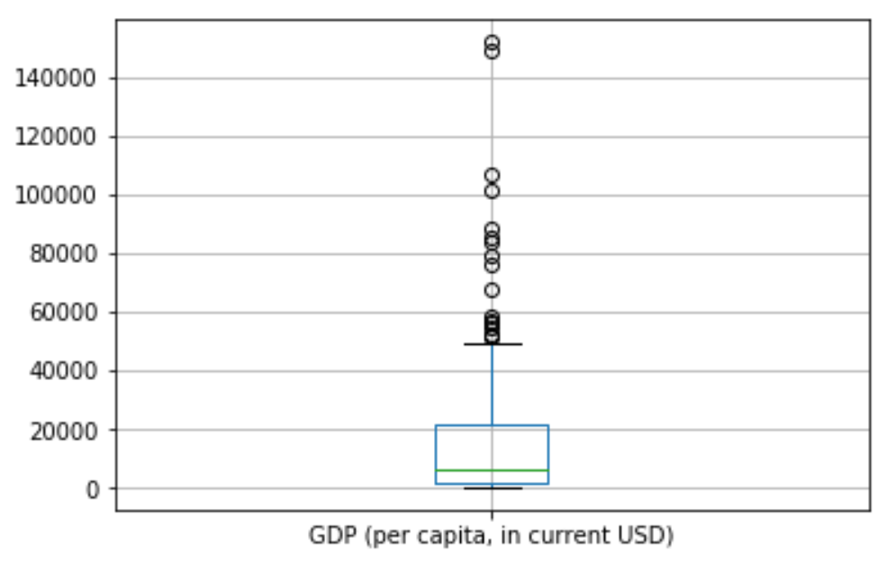
Boxplot of gdp data

Slide 31
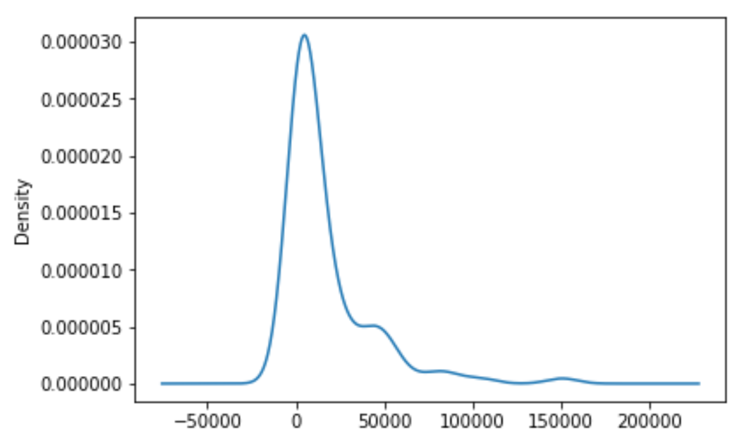
Kde of gdp data

Slide 32
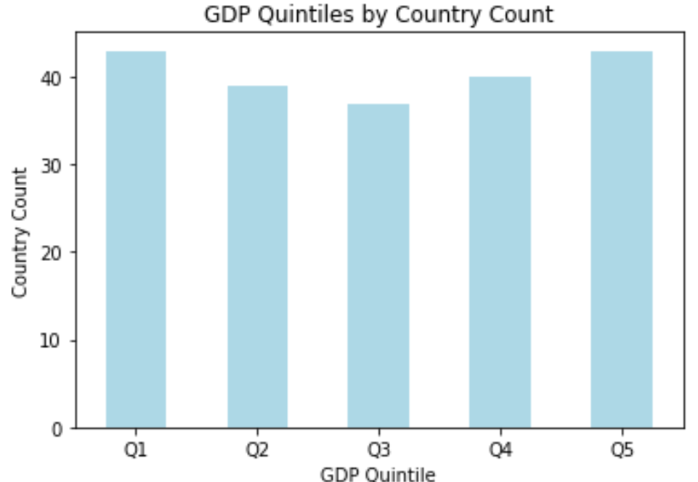
Count of gdp quintile groups

Slide 33
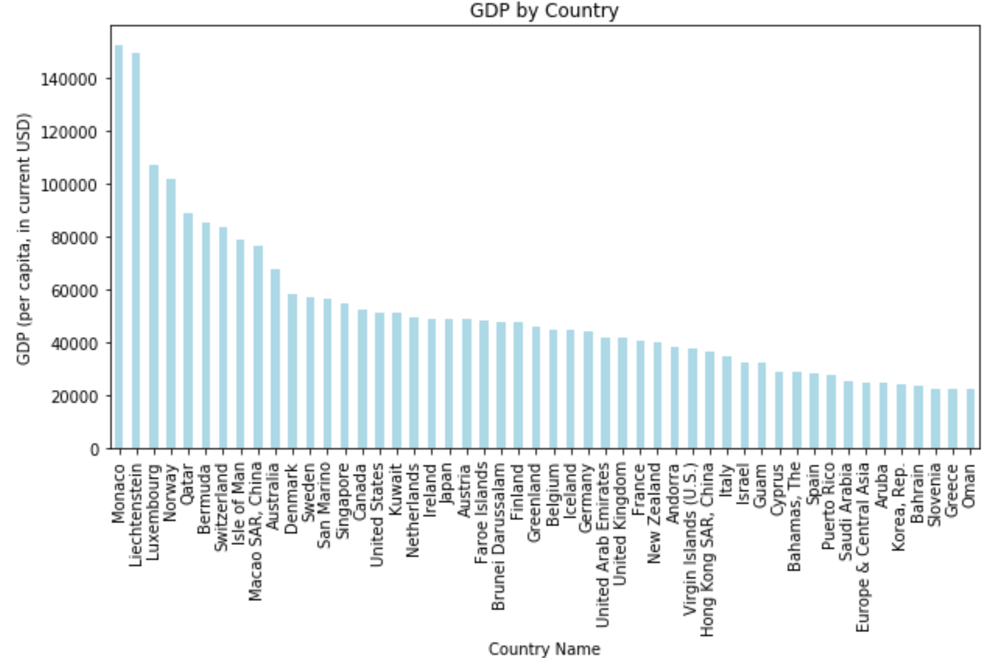
50 countries w/ highest gdp

Slide 34
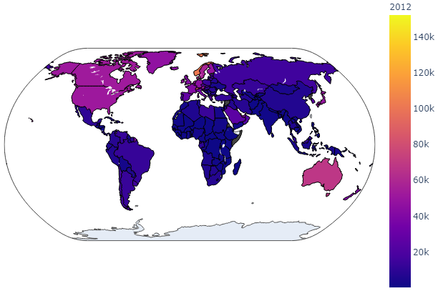
A bird’s-eye view of 2012 gdp data

Slide 35
Considerations
What do our findings mean?
Limitations of our work?
Additional research needed?

Slide 36
considerations
Definition of “infant”
SIDS (R99)
ICD codes (all the revisions)
Missing data (lower income countries)

Slide 37
Analysis / COnclusions

Slide 38
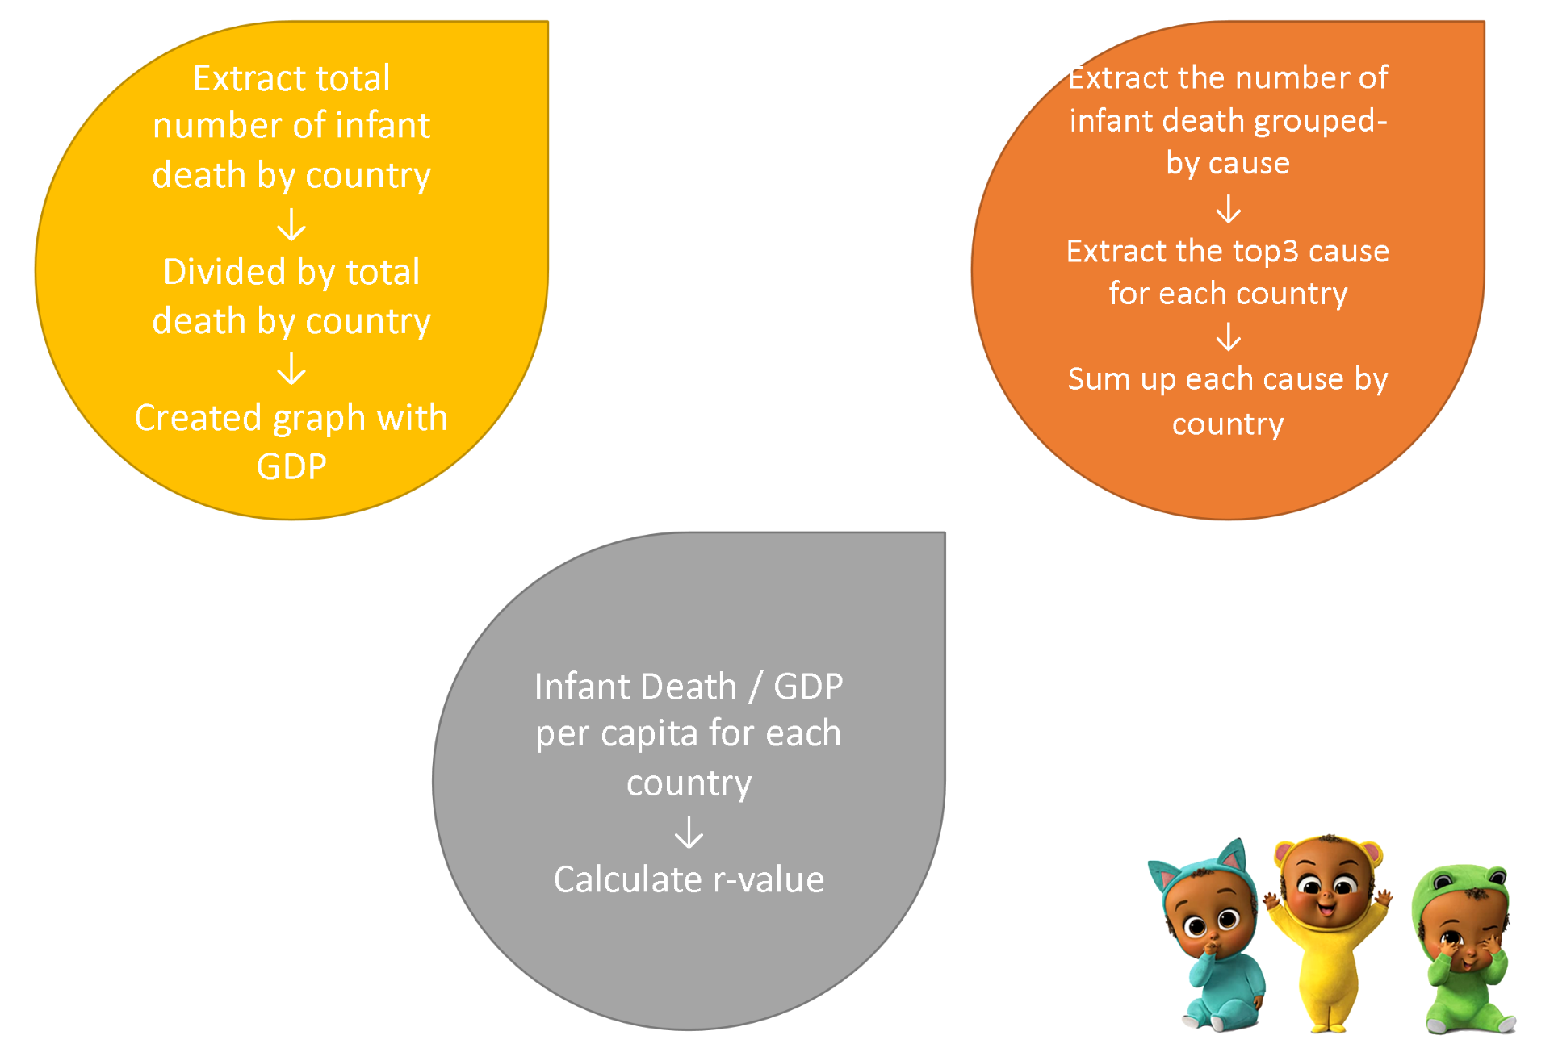
Our approach

Slide 39
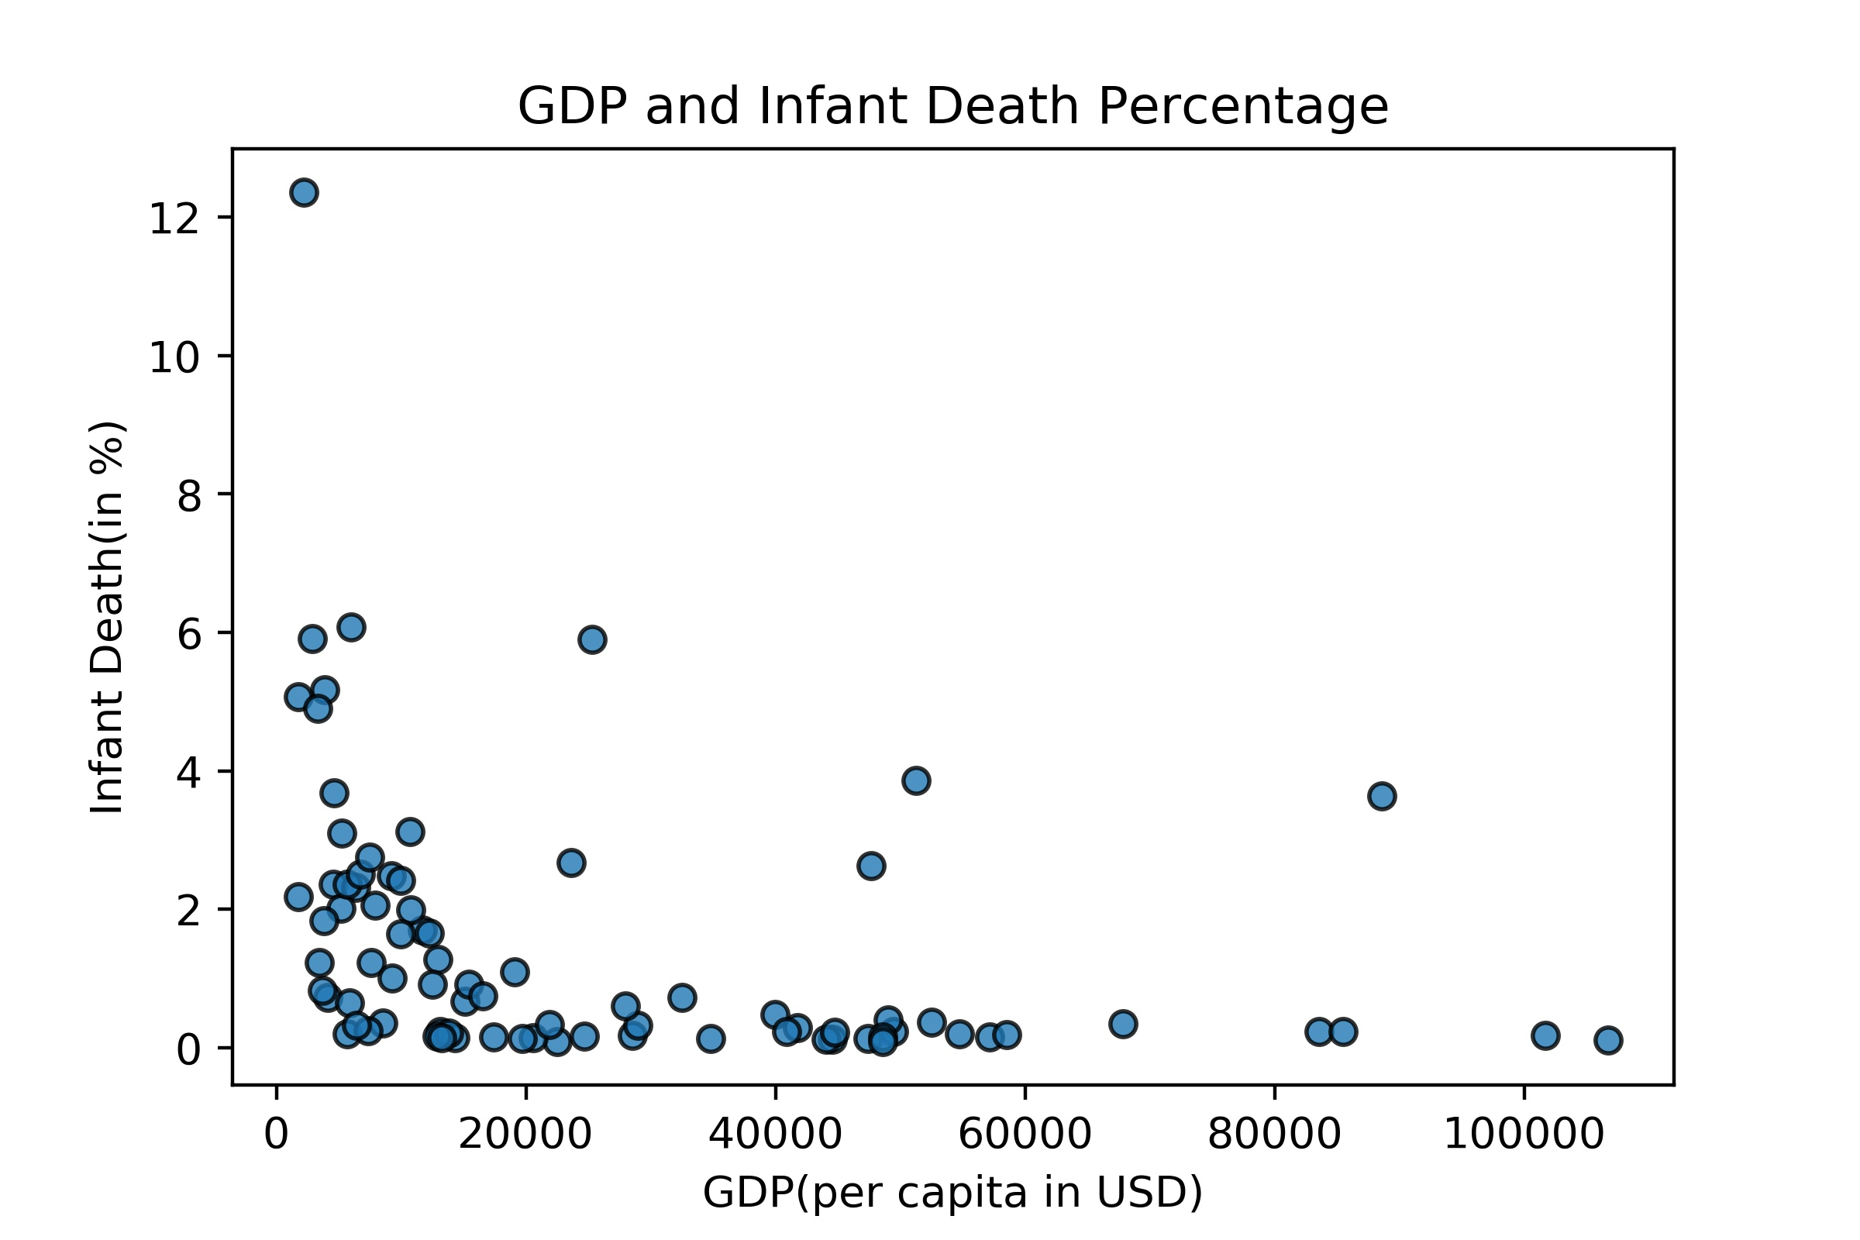
Scatter plot of Death rate vs. gdp

Slide 40
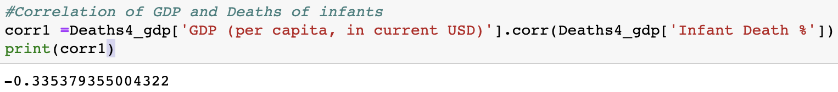
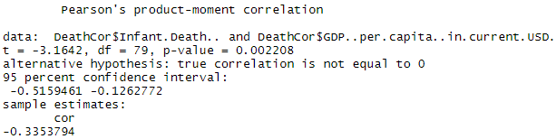
Test for correlation

Slide 41
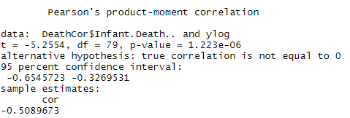
Exponential correlation

Slide 42
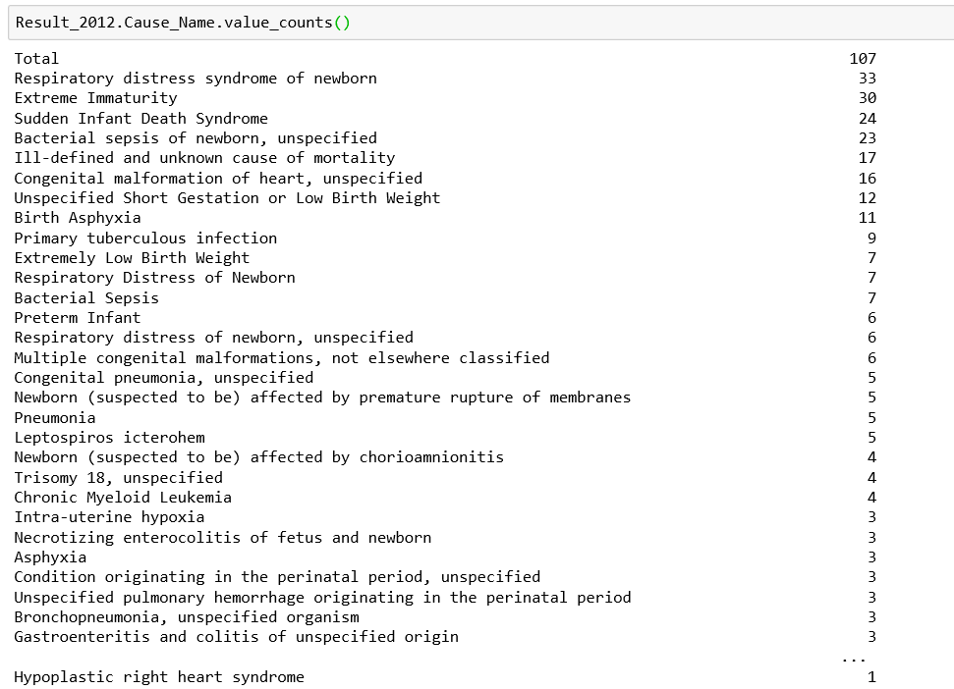
Sum of top 3 causes of death
293,923 total infant deaths in 2012

Slide 43
Top 5 Causes

Slide 44
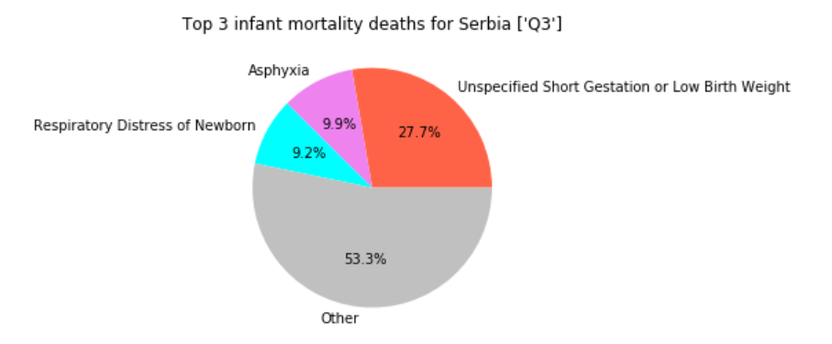
Top 3 causes of death vs. total
$5,659.38
Q1
Q2
Q3
Q4
Q5
POOR
RICH

Slide 45
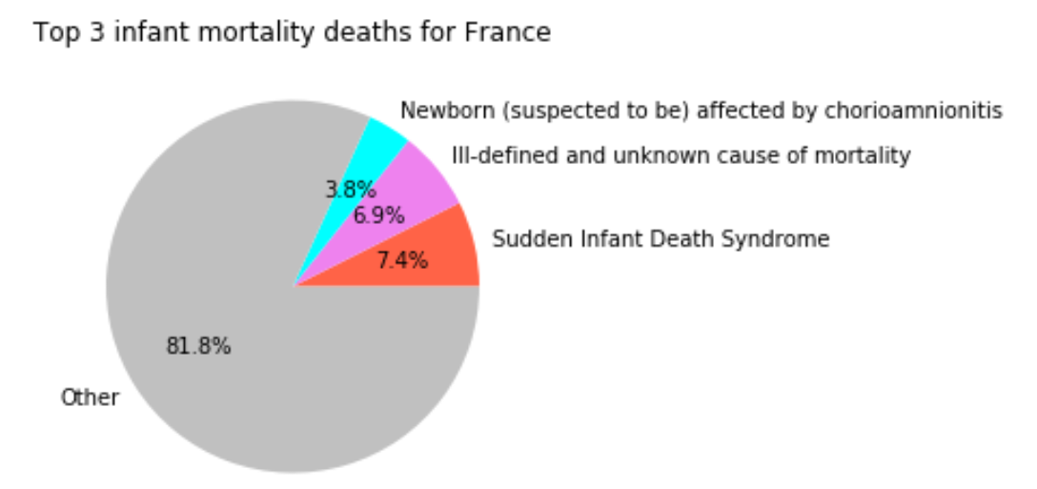
Top 3 causes of death vs. total
$40,874.71
Q1
Q2
Q3
Q4
Q5
POOR
RICH

Slide 46
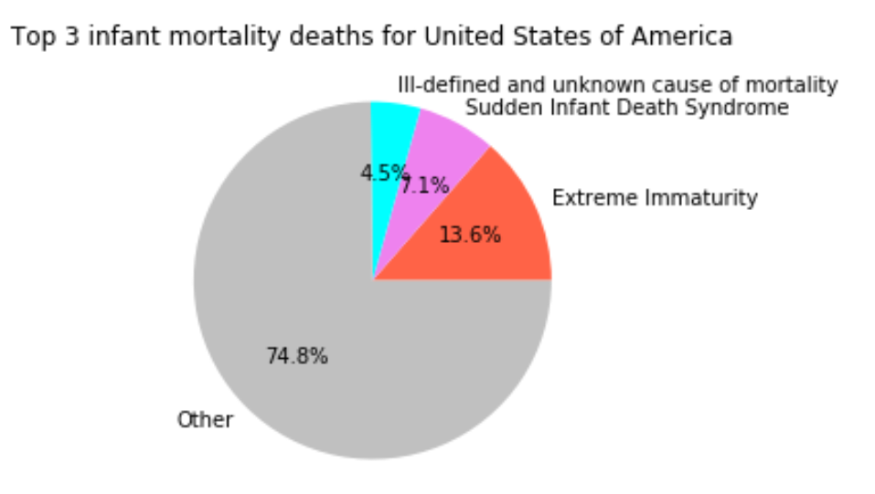
Top 3 causes of death vs. total
$51,450.95
Q1
Q2
Q3
Q4
Q5
POOR
RICH

Slide 47
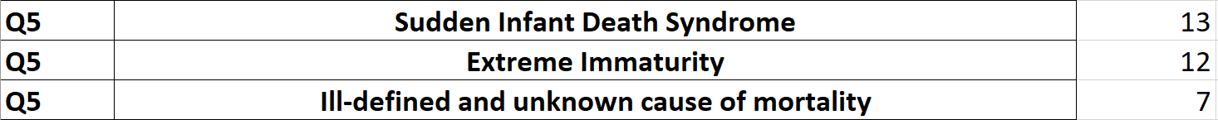
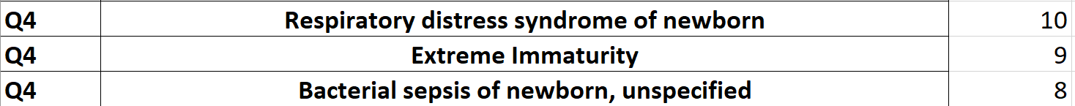
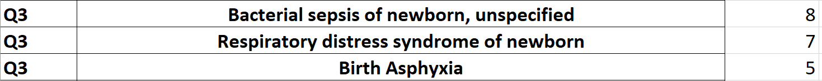
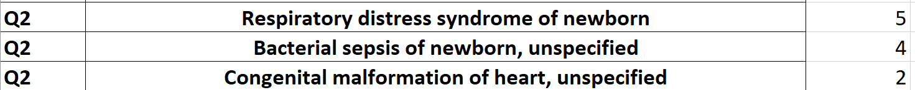

Slide 48
Call to action
Fork the repo (“Mere Mortals” on Donish Cushing’s GitHub)
Use “Starter Notebook” to make core data pulls
Increase awareness (if only your own)

